Slide 1
Numerical minimization
AKA “Guess-and-check” but better and you don’t have to write it yourself

Slide 2
What is a minimum?
Let’s say we have some function f(x)
The minimum is the lowest value of the function. To minimize is to find the value of x where f(x) is the lowest.
The minimum of a function occurs where:
the derivative f’(x) = 0
the second derivative f’’(x) > 0.

Slide 3
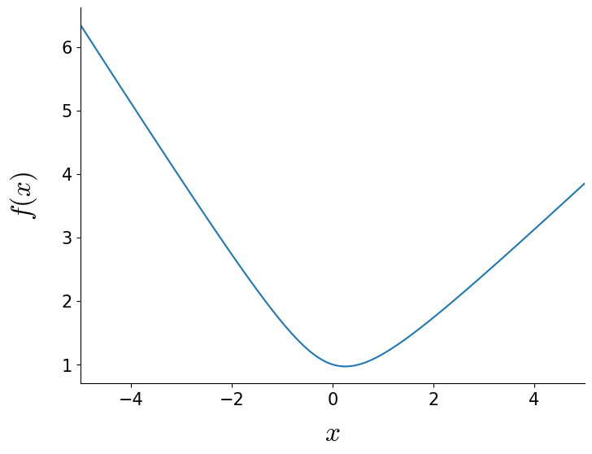
What is a minimum?
Let’s say we have some function f(x)
The minimum is the lowest value of the function. To minimize is to find the value of x where f(x) is the lowest.
The minimum of a function occurs where:
the derivative f’(x) = 0
the second derivative f’’(x) > 0.
f’’(x) > 0
f’(x) = 0

Slide 4

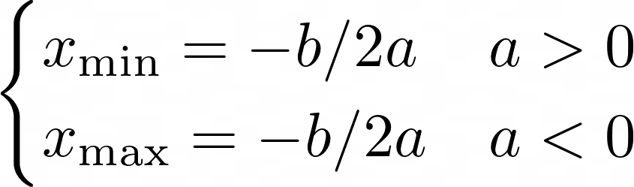


What is a minimum?
Most basic example: Quadratic function

Slide 5
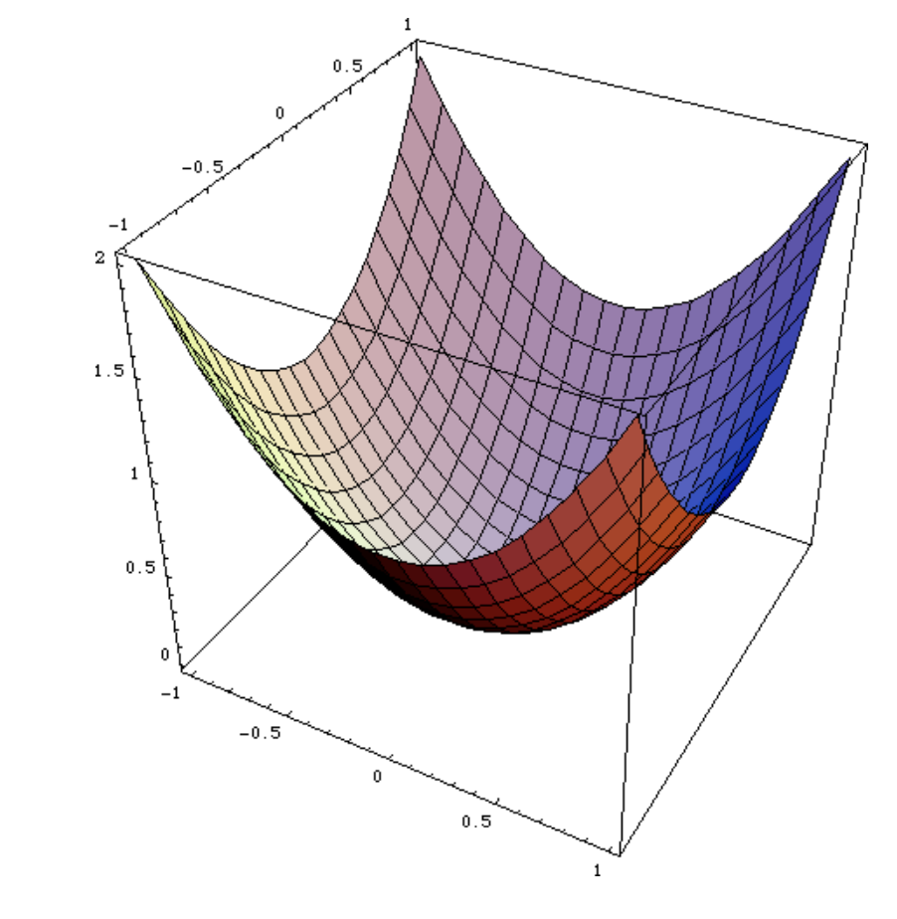
Important function properties
Functions can be minimized easily if they are:
Convex: function that only has one minimum
Differentiable/smooth: derivative of the function can be calculated everywhere
ꭓ² functions are generally convex and smooth → easy to minimize

Slide 6
Minimizing a 1D convex, smooth function - Line search

Slide 7
Minimizing a 1D convex, smooth function - Line search
a
b
c
Choose two points that bracket the minimum a and c and compute their functional values f(a) and f(c)
Choose a point b between a and c and compute f(b)
f(a)
f(c)
f(b)

Slide 8
Minimizing a 1D convex, smooth function - Line search
a
b
d
c
“Probe” the function:
Choose a new x value d in the middle of the larger interval of [a,b] or [b,c] and compute f(d).
b − a
b − c
f(a)
f(c)
f(b)
f(d)

Slide 9
Minimizing a 1D convex, smooth function - Line search
a
b
d
c
Compare f(d) and f(b)
f(a)
Compare: f(d) and f(b)
whichever is lower is the new “middle point”
f(c)
f(b)
f(d)

Slide 10
Minimizing a 1D convex, smooth function - Line search
a
b
c
Compare f(d) and f(b)
Redefine a, b, and c such that the interval is centered at the lowest value of f(x) computed so far
And repeat with our new a, b, c
f(c)
f(a)
f(b)

Slide 11
Minimizing a 1D convex, smooth function - Line search
Many steps later…
f(c)
f(a)
f(b)

Slide 12
Minimizing a 1D convex, smooth function - Line search
a
b
c
The midpoint b will approach the true minimum but will never be exactly correct:
Eventually we have to say “good enough” and stop repeating these steps
Tolerance (tol) – how close to the minimum do we want to get
f(c)
f(a)
f(b)

Slide 13
Minimizing a 1D convex, smooth function - Line search
a
b
c
e.g. tol = 1e-8
f(c)
f(a)
f(b)

Slide 14
Minimizing a 1D convex, smooth function - Line search
d
a
b
c
e.g. tol = 1e-8
If f(b) – f(d) < 10⁻⁸, we can say that we have found the minimum at x = d.
f(c)
f(a)
f(b)
f(d)

Slide 15
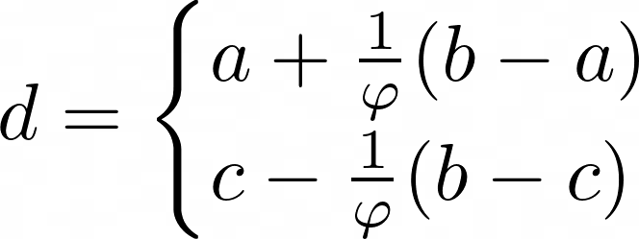
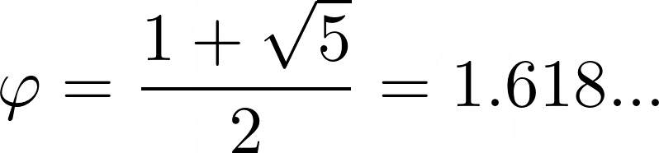
Golden-section search
How to pick d?
Depending on which interval we are splitting:
“Golden ratio”

Slide 16
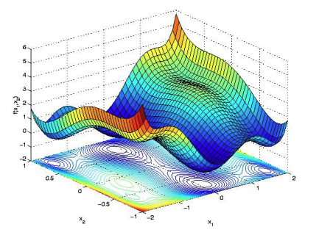
Non-convex and multimodal functions
These require more complex algorithms for optimization
Commonly used in astronomy: Markov Chain Monte Carlo (MCMC)

Slide 17
Other methods:
https://www.benfrederickson.com/numerical-optimization/
More complex algorithms for minimizing 1D functions
Minimizing functions in two or more dimensions

